Slide 1

KELOMPOK - 4
ANIMAL CLASSIFICATION
Tugas Besar Machine Learning

Slide 2
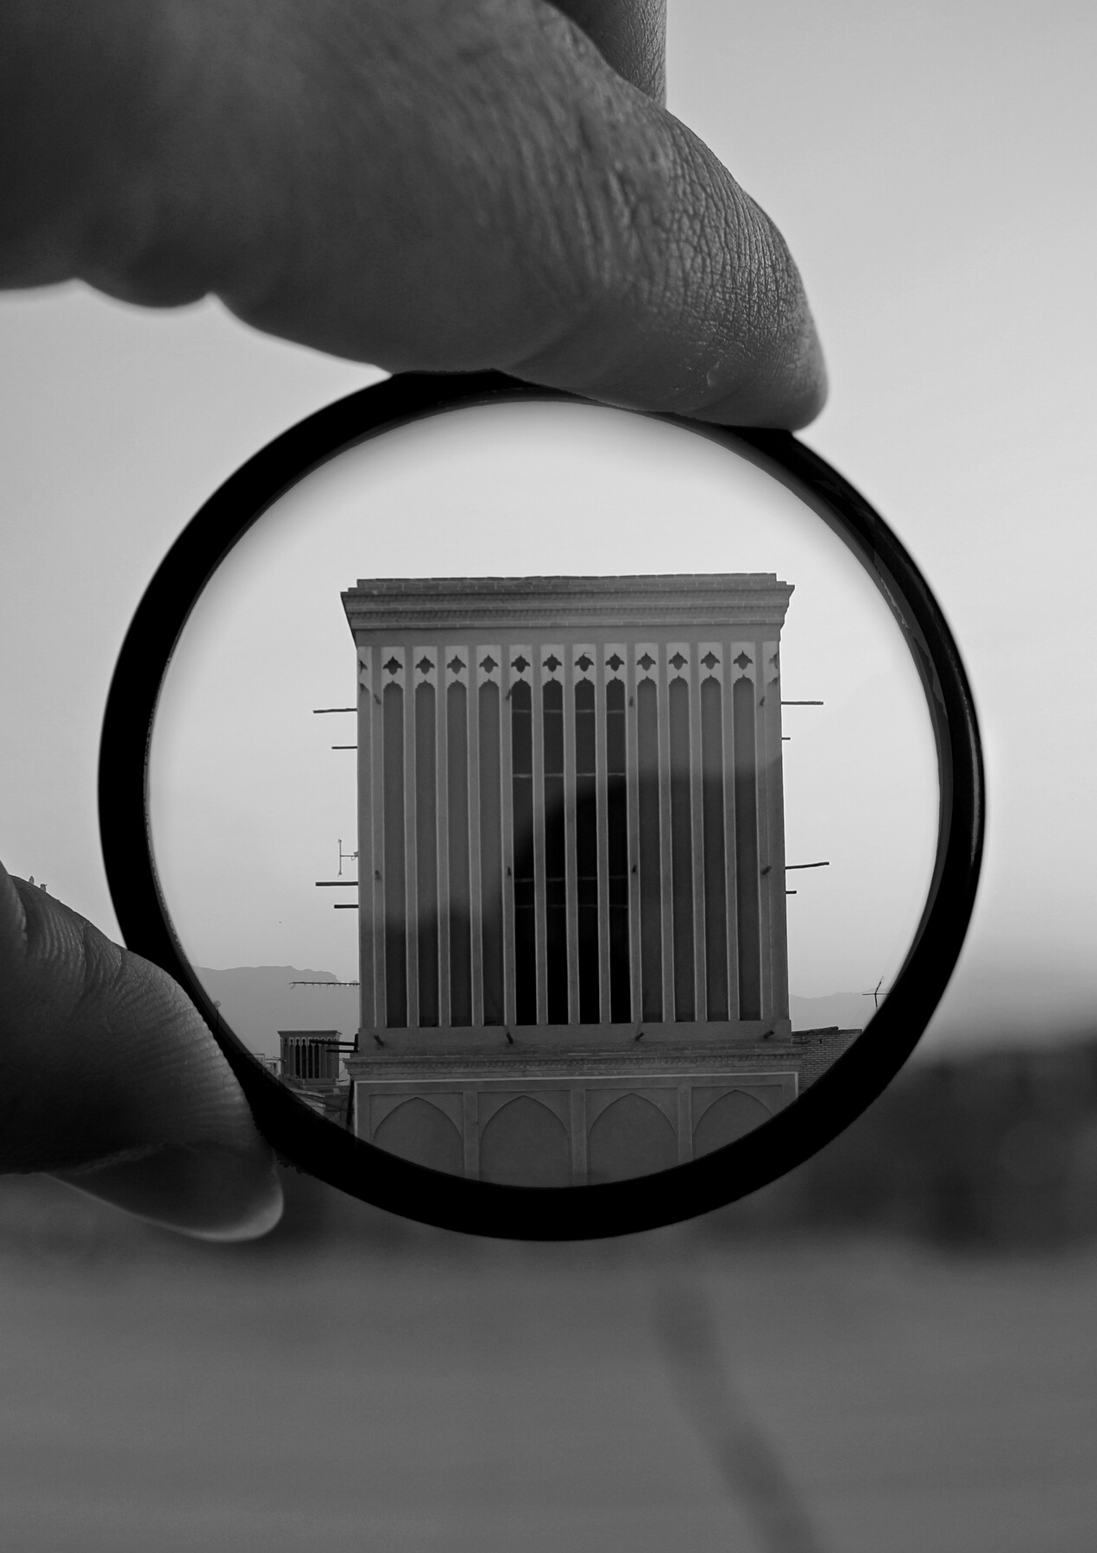
ANGGOTA
Muhammad Rizqi Mubarak
Yusril Firza
Muh Rico Andreas
Abdul Manan
Muhammad Wahyu Putra Indi
Yusuf Azam Sya’bani

Slide 3

CNN
CONVOLUTIONAL NEURAL NETWORK

Slide 4
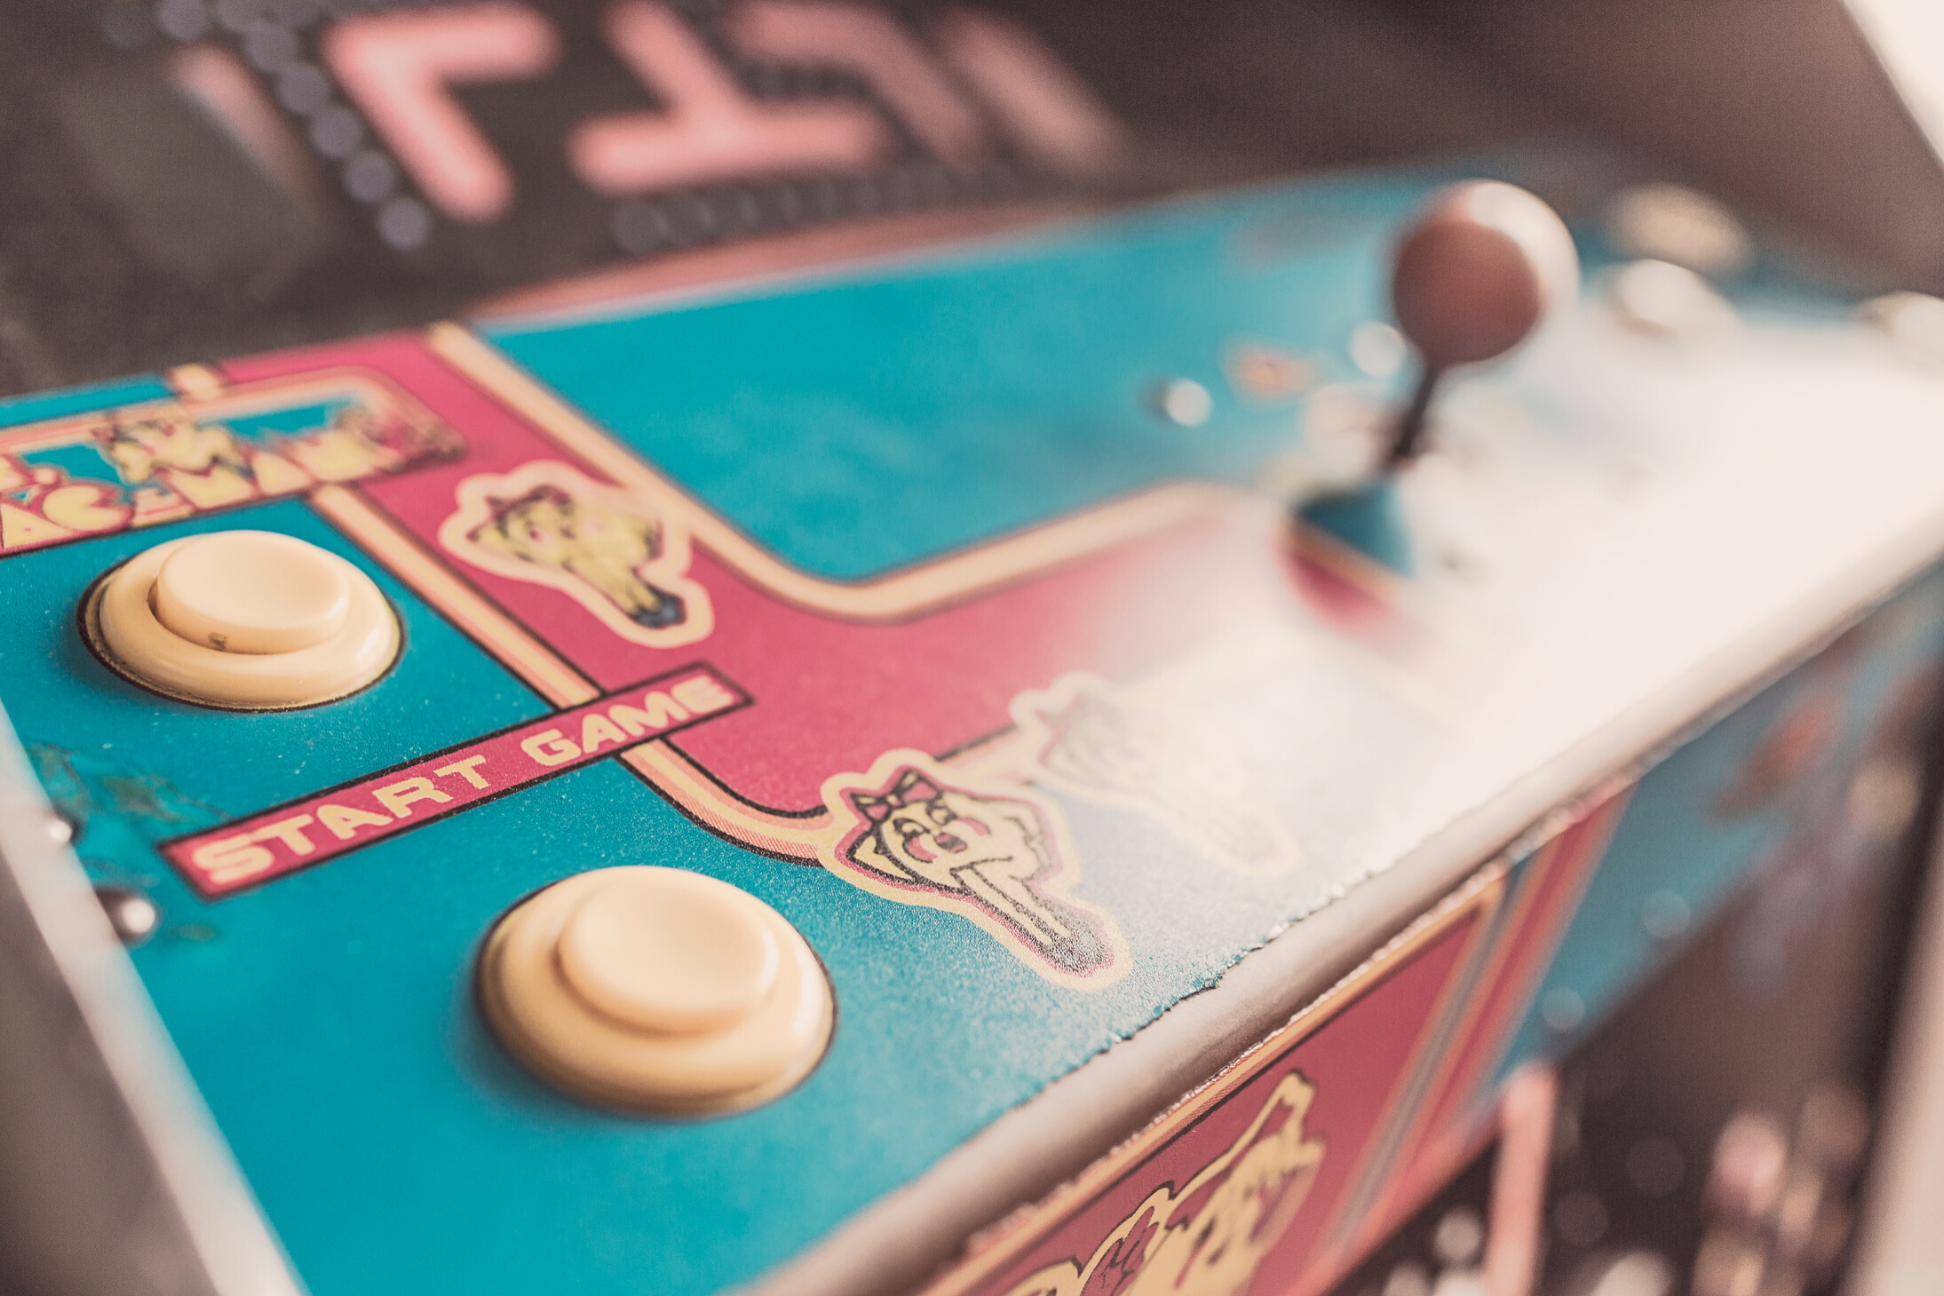
CNN
Convolutional Neural Network adalah salah satu metode machine learning dari pengembangan Multi Layer Perceptron (MLP) yang didesain untuk mengolah data dua dimensi.

Slide 5
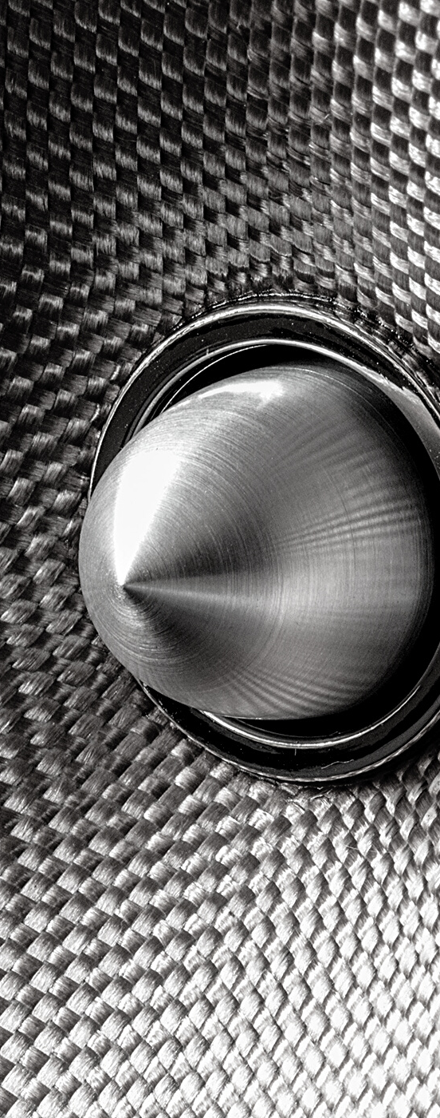
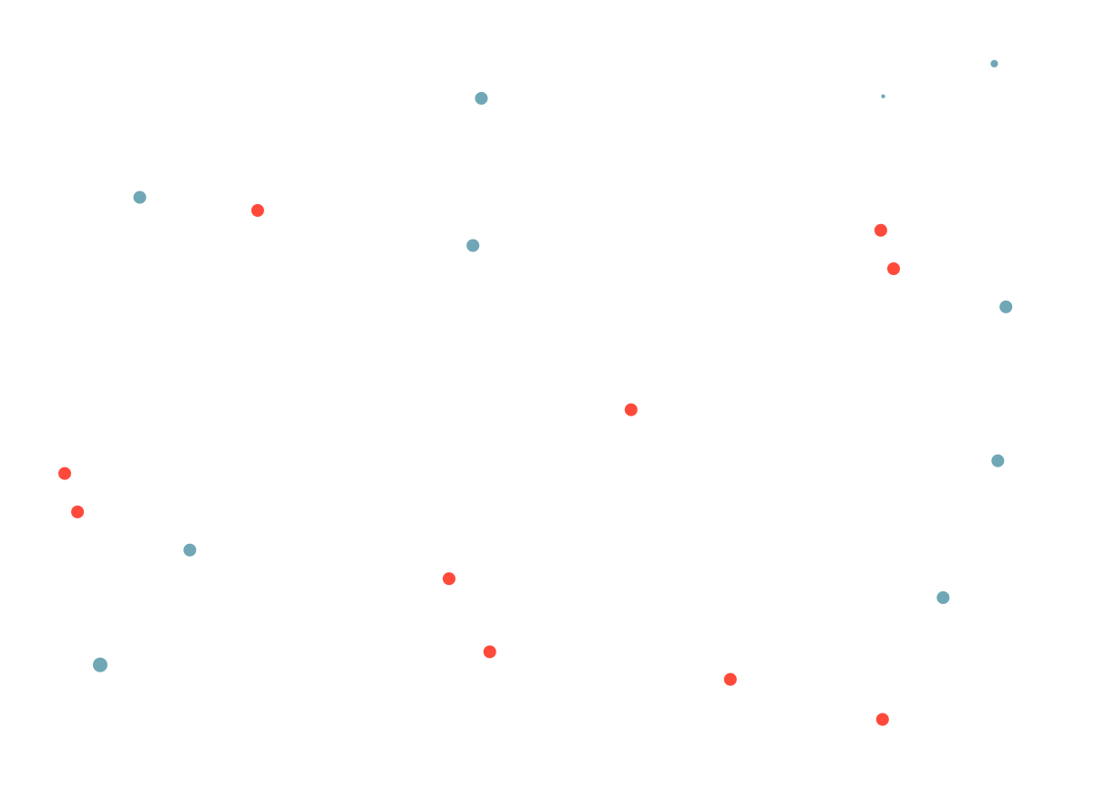
CNN
CNN termasuk dalam jenis Deep Neural Network karena dalamnya tingkat jaringan dan banyak diimplementasikan dalam data citra.
Cara kerja CNN memiliki kesamaan pada MLP, namun dalam CNN setiap neuron dipresentasikan dalam bentuk dua dimensi, tidak seperti MLP yang setiap neuron hanya berukuran satu dimensi
CNN merupakan pengembangan lebih lanjut dari MLP karena menggunakan metode yang mirip dengan dimensi yang lebih banyak.

Slide 6
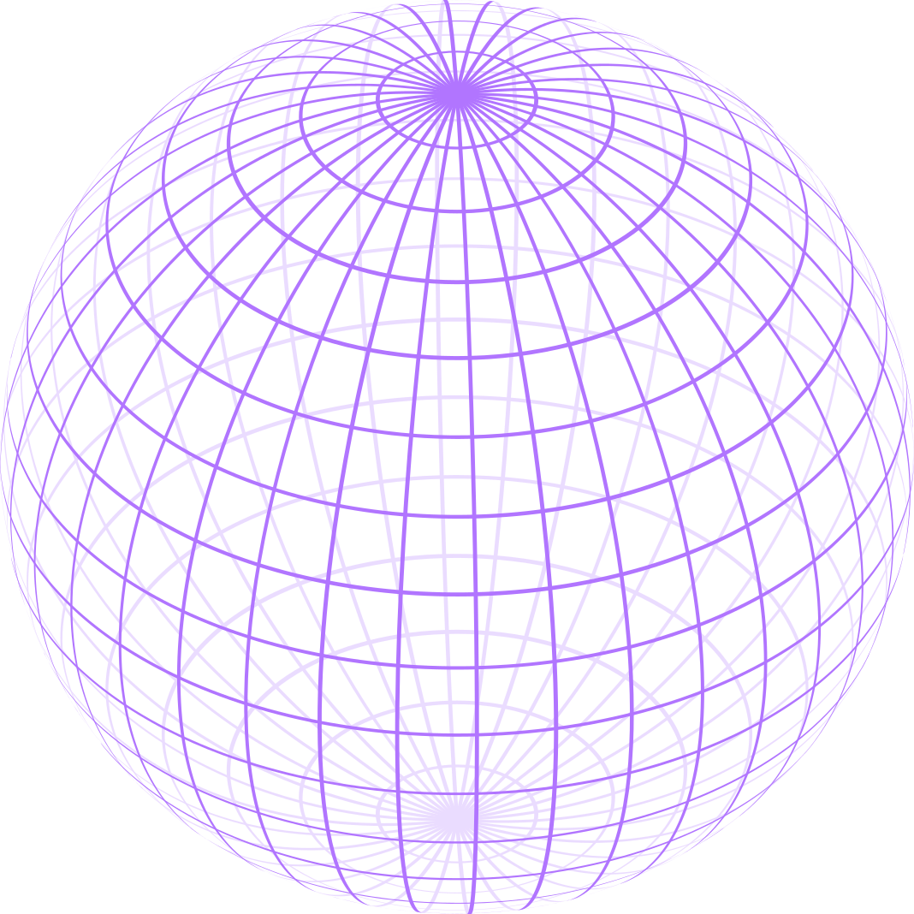
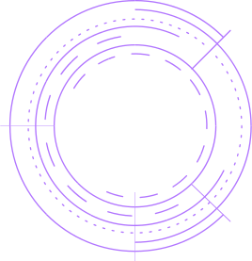
Input Layer
CNN LAYER
Hidden Layer
Output Layer

Slide 7


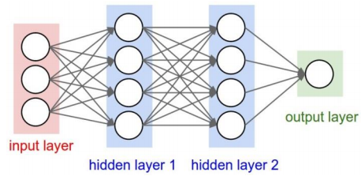
Sebuah MLP seperti pada disamping memiliki i layer (kotak merah dan biru) dengan masing-masing layer berisi ji neuron (lingkaran putih). MLP menerima input data satu dimensi dan mempropagasikan data tersebut pada jaringan hingga menghasilkan output.
Setiap hubungan antar neuron pada dua layer yang bersebelahan memiliki parameter bobot satu dimensi yang menentukan kualitas mode.
Disetiap data input pada layer dilakukan operasi linear dengan nilai bobot yang ada, kemudian hasil komputasi akan ditransformasi menggunakan operasi non linear yang disebut sebagai fungsi aktivasi.
Data yang dipropagasikan pada CNN adalah data dua dimensi, sehingga operasi linear dan parameter bobot pada CNN berbeda.
CNN LAYER

Slide 8
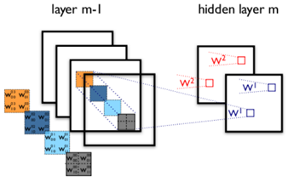
CONT.
Operasi linear pada CNN menggunakan operasi konvolusi, dengan bobot yang tidak lagi satu dimensi saja, namun berbentuk empat dimensi yang merupakan kumpulan kernel konvolusi seperti pada gambar di atas.

Slide 9

Hasil Pengerjaan
Tugas Besar Machine Learning

Slide 10

Source code
Kaggle
https://www.kaggle.com/min4tozaki/animal-classification
Google Colab
https://min4tozaki.me/tubes-ml
Github
https://github.com/min4tozaki/tubes_ml

Slide 11
Dataset
Kaggle
https://www.kaggle.com/alessiocorrado99/animals10
z

Slide 12




TOOLS
PYTHON
JUPYTER NOTEBOOK
GOOGLE COLAB
KAGGLE KERNEL

Slide 13



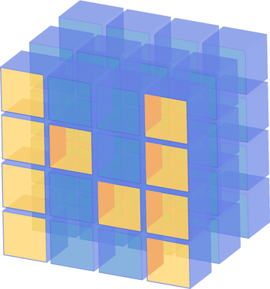


Python Requirements
TENSORFLOW
KERAS
PANDAS
NUMPY
OPENCV
SCIKIT-LEARN

Slide 14

Tensorflow Models
base_model = applications.VGG16(
weights='imagenet',
include_top=False,
input_shape=(img_rows, img_cols, img_channel)
)
add_model = Sequential()
add_model.add(Flatten(input_shape=base_model.output_shape[1:]))
add_model.add(Dense(256, activation='relu'))
add_model.add(Dense(10, activation='softmax'))
model = Model(
inputs=base_model.input,
outputs=add_model(base_model.output)
)
model.compile(
loss='binary_crossentropy',
optimizer=optimizers.SGD(lr=1e-4, momentum=0.9),
metrics=['accuracy']
)
batch_size = 32
epochs = 50

Slide 15

TENSORFLOW
For this model is highly recommended using GPU because the process is much faster then using CPU for process
GPU VS CPU
GPU
40s - 60s per epoch
CPU
20m - 30m per epoch

Slide 16
Model: "model"
_________________________________________________________________
Layer (type) Output Shape Param #
=================================================================
input_1 (InputLayer) (None, 224, 224, 3) 0
_________________________________________________________________
block1_conv1 (Conv2D) (None, 224, 224, 64) 1792
_________________________________________________________________
block1_conv2 (Conv2D) (None, 224, 224, 64) 36928
_________________________________________________________________
block1_pool (MaxPooling2D) (None, 112, 112, 64) 0
_________________________________________________________________
block2_conv1 (Conv2D) (None, 112, 112, 128) 73856
_________________________________________________________________
block2_conv2 (Conv2D) (None, 112, 112, 128) 147584
_________________________________________________________________
block2_pool (MaxPooling2D) (None, 56, 56, 128) 0
_________________________________________________________________
block3_conv1 (Conv2D) (None, 56, 56, 256) 295168
_________________________________________________________________
block3_conv2 (Conv2D) (None, 56, 56, 256) 590080
_________________________________________________________________
block3_conv3 (Conv2D) (None, 56, 56, 256) 590080
_________________________________________________________________
block3_pool (MaxPooling2D) (None, 28, 28, 256) 0
_________________________________________________________________
block4_conv1 (Conv2D) (None, 28, 28, 512) 1180160
_________________________________________________________________
block4_conv2 (Conv2D) (None, 28, 28, 512) 2359808
_________________________________________________________________
block4_conv3 (Conv2D) (None, 28, 28, 512) 2359808
_________________________________________________________________
block4_pool (MaxPooling2D) (None, 14, 14, 512) 0
_________________________________________________________________
block5_conv1 (Conv2D) (None, 14, 14, 512) 2359808
_________________________________________________________________
block5_conv2 (Conv2D) (None, 14, 14, 512) 2359808
_________________________________________________________________
block5_conv3 (Conv2D) (None, 14, 14, 512) 2359808
_________________________________________________________________
block5_pool (MaxPooling2D) (None, 7, 7, 512) 0
_________________________________________________________________
sequential_1 (Sequential) (None, 10) 6425354
=================================================================
Total params: 21,140,042
Trainable params: 21,140,042
Non-trainable params: 0
_________________________________________________________________
OUTPUT MODELS

Slide 17

TRAINING
INPUT
data train = 4000 (400/animal)
data test = 1000 (100/animal)

Slide 18



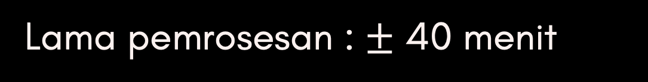
Training Process
Epoch 1/50
125/125 [==============================] - 53s 426ms/step - loss: 0.3281 - accuracy: 0.9000 - val_loss: 0.3152 - val_accuracy: 0.9000
Epoch 2/50
125/125 [==============================] - 48s 387ms/step - loss: 0.3143 - accuracy: 0.9000 - val_loss: 0.3028 - val_accuracy: 0.9000
Epoch 3/50
125/125 [==============================] - 47s 377ms/step - loss: 0.3023 - accuracy: 0.9000 - val_loss: 0.2869 - val_accuracy: 0.9000
Epoch 4/50
125/125 [==============================] - 47s 373ms/step - loss: 0.2867 - accuracy: 0.9001 - val_loss: 0.2645 - val_accuracy: 0.9023
Epoch 5/50
125/125 [==============================] - 46s 372ms/step - loss: 0.2680 - accuracy: 0.9023 - val_loss: 0.2409 - val_accuracy: 0.9084
.
.
.
Epoch 49/50
125/125 [==============================] - 46s 368ms/step - loss: 0.0459 - accuracy: 0.9837 - val_loss: 0.0722 - val_accuracy: 0.9728
Epoch 50/50
125/125 [==============================] - 47s 372ms/step - loss: 0.0450 - accuracy: 0.9844 - val_loss: 0.0702 - val_accuracy: 0.9737
Lama pemrosesan : $±$ 40 menit

Slide 19
TRAINING OUTPUT
CNN : Epochs=50, Train accuracy=0.98438, Validation accuracy=0.97370

Slide 20
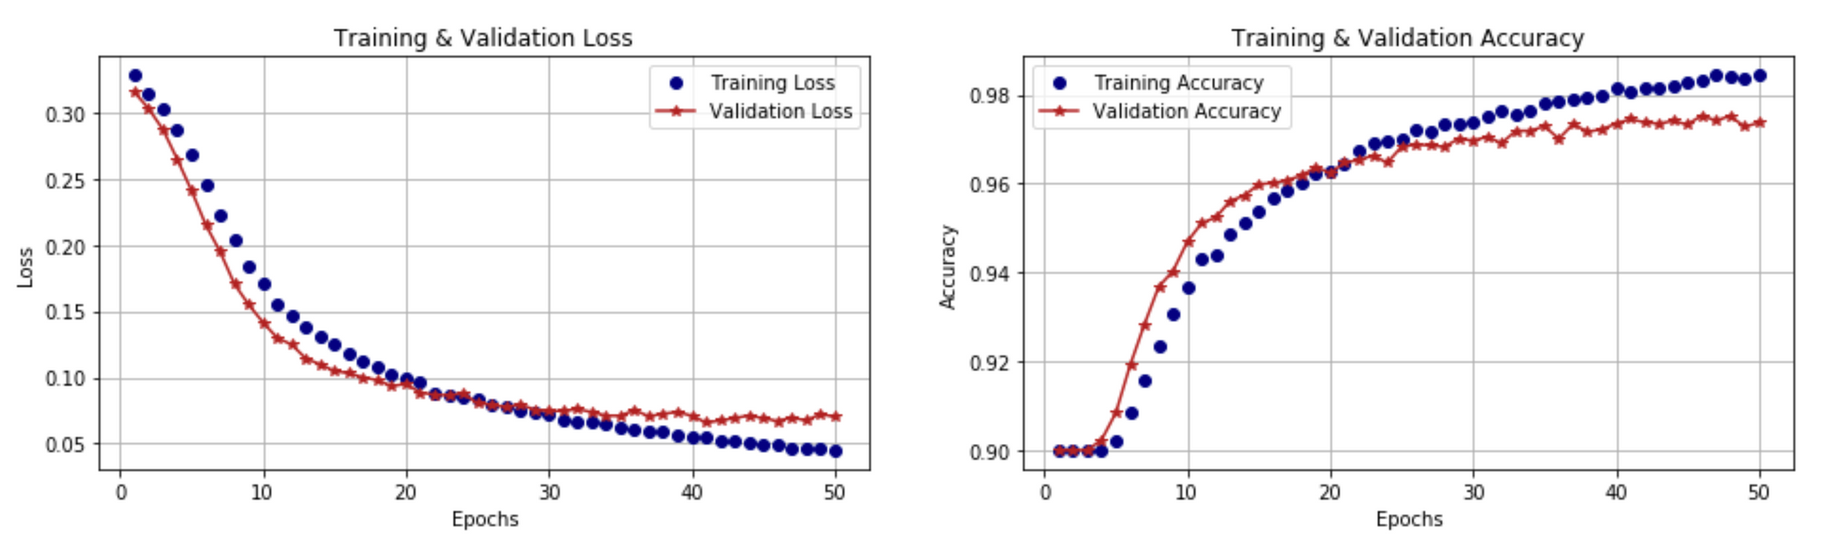
ACCURACY

Slide 21



Manual Testing

Slide 22
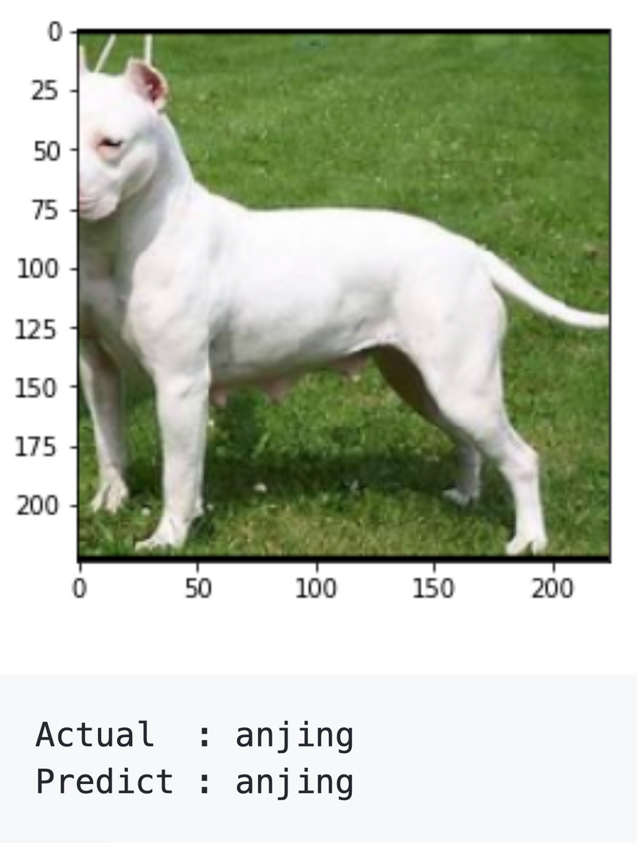
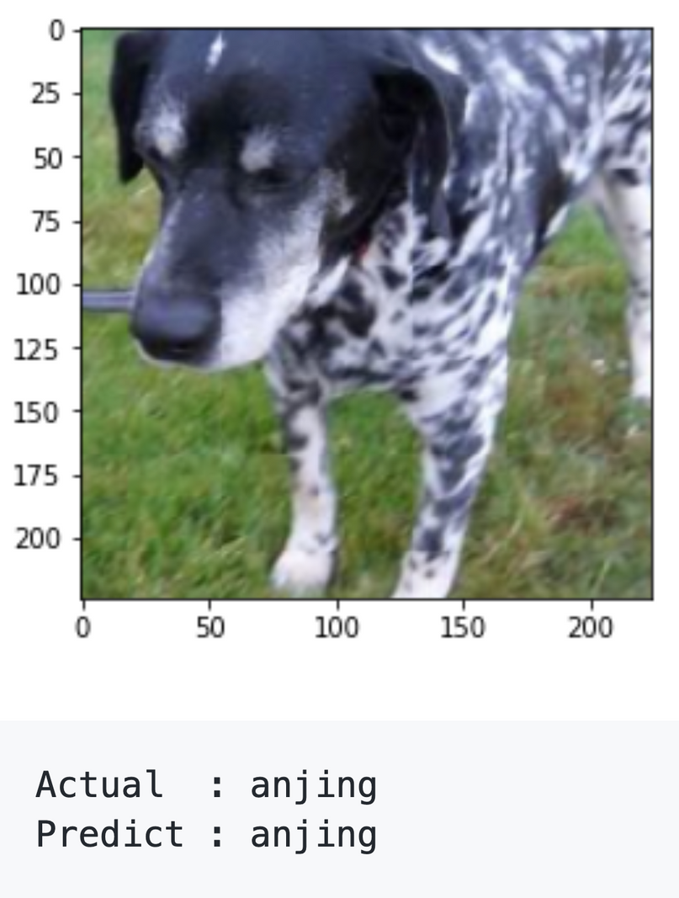
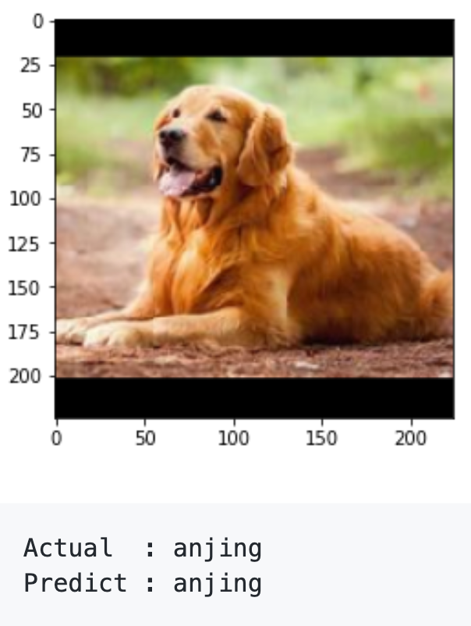

Slide 23
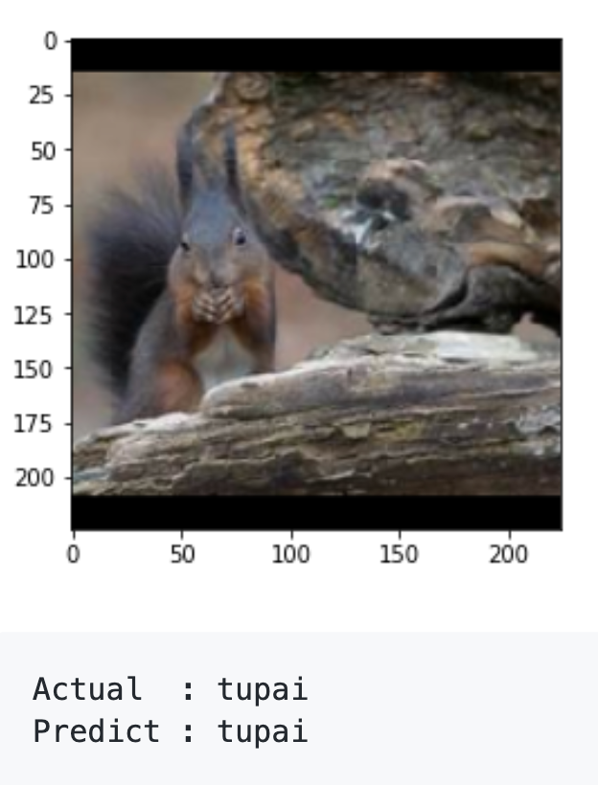
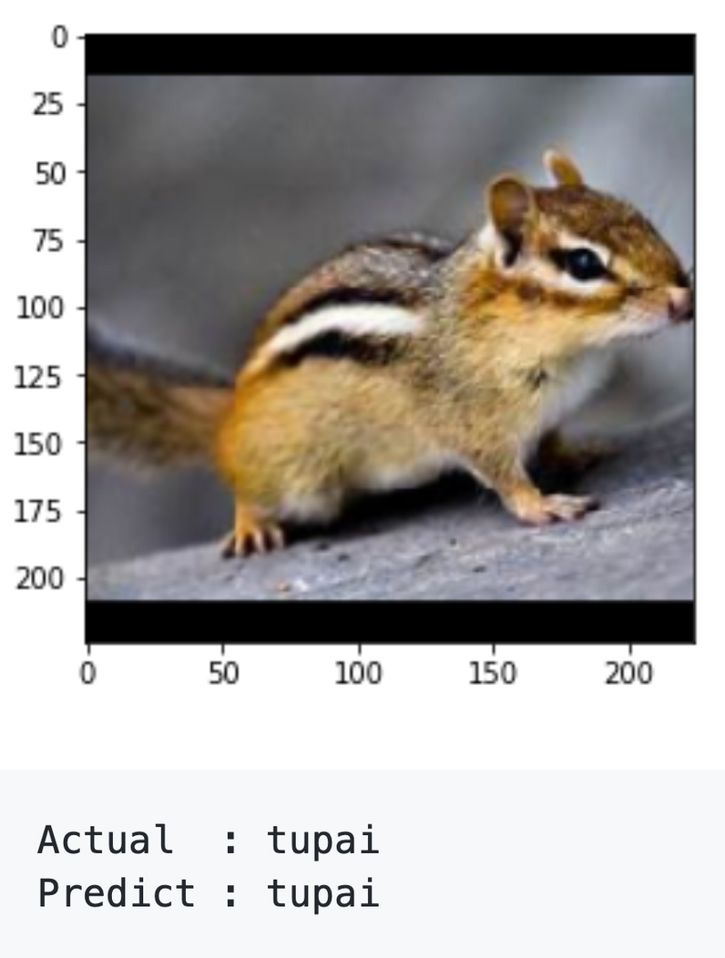
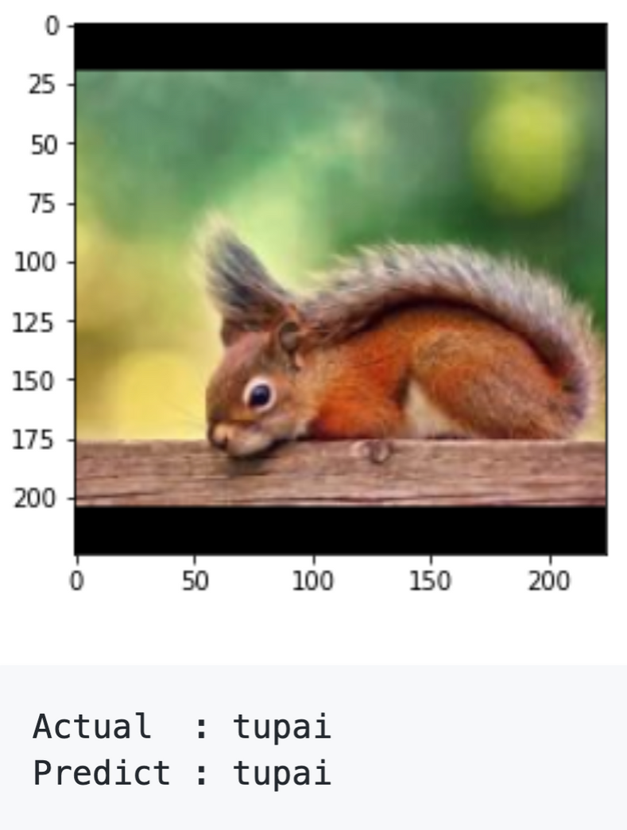

Slide 24
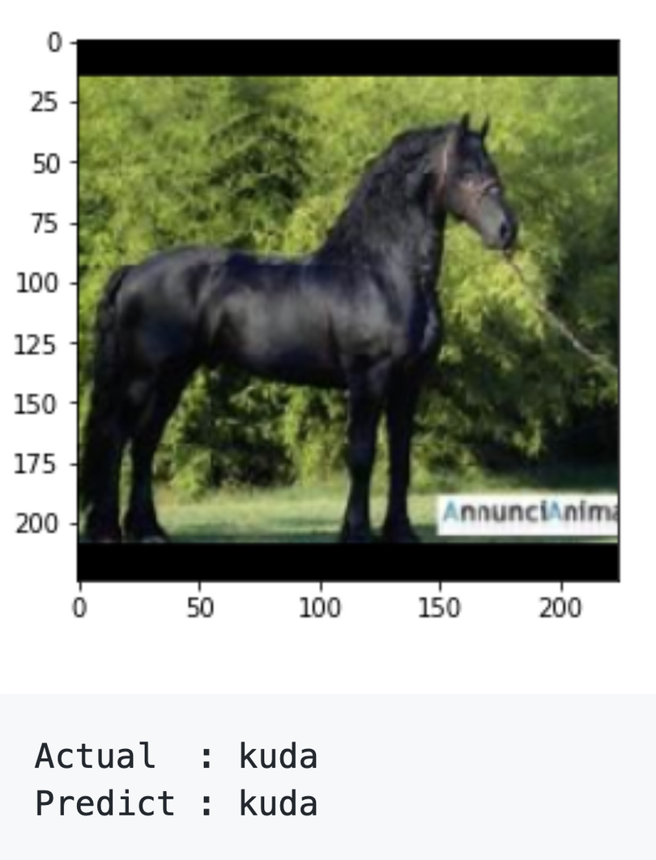
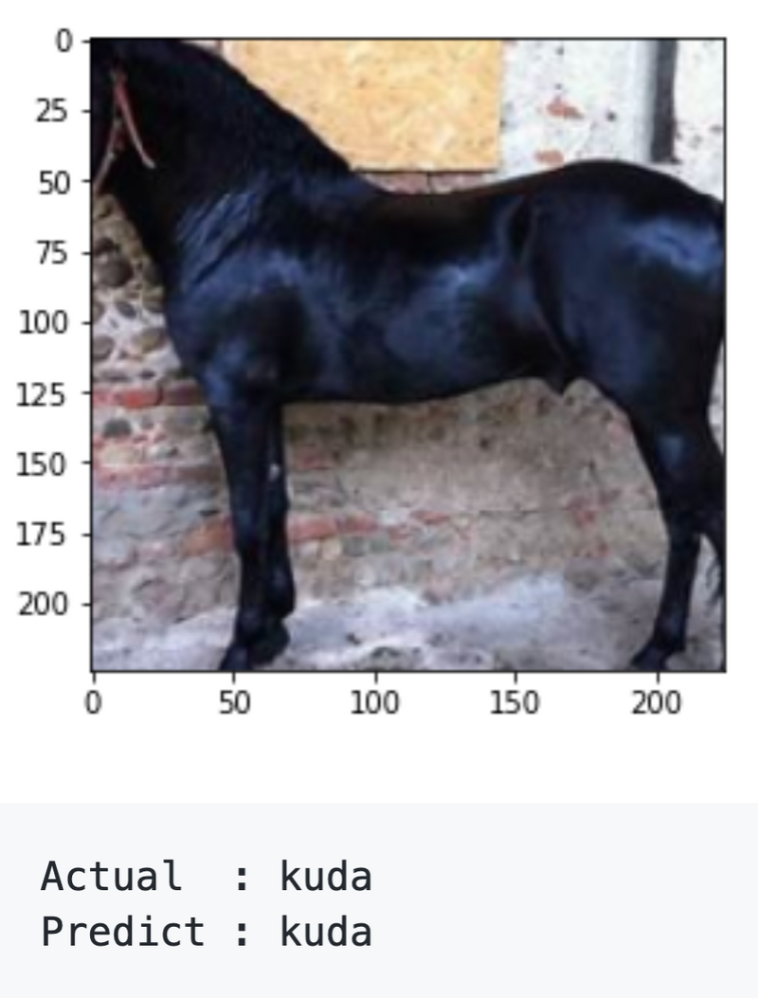
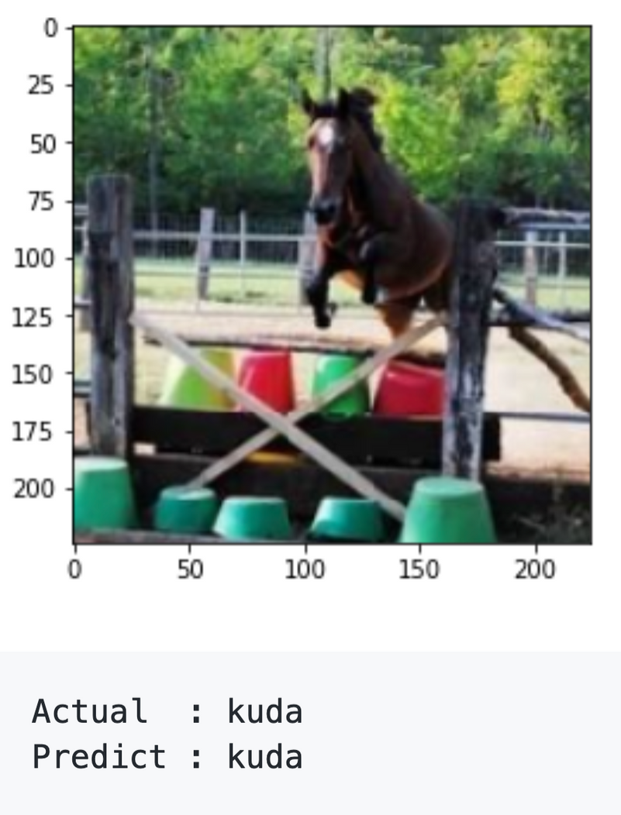

Slide 25
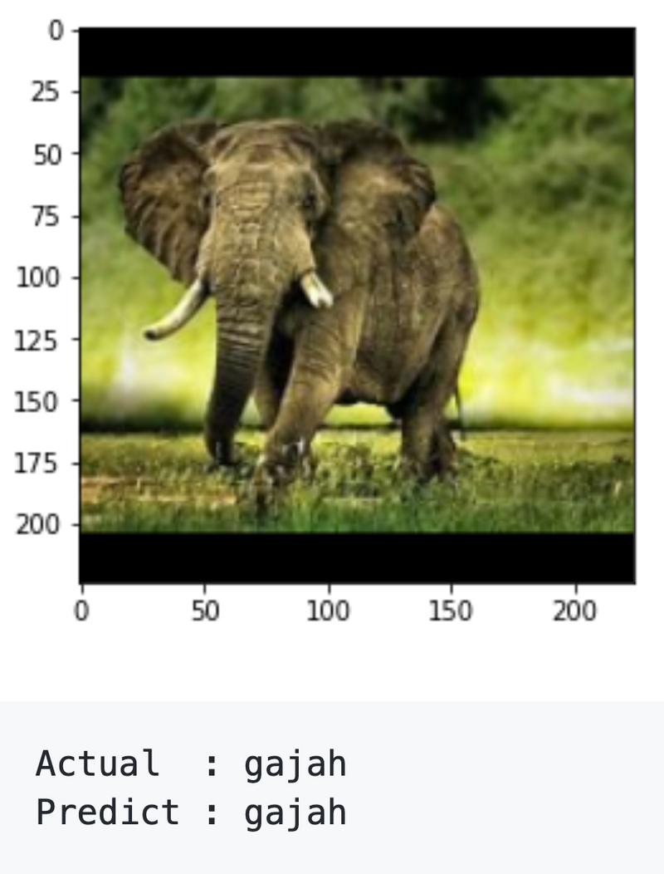
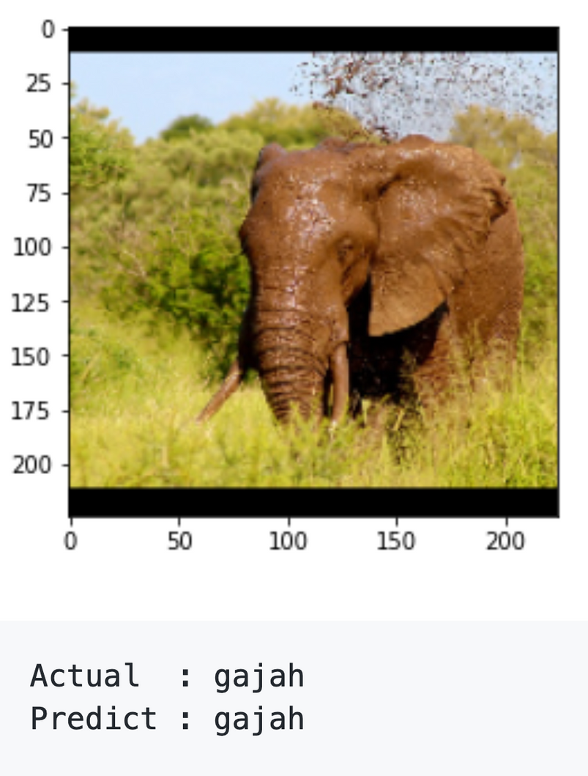
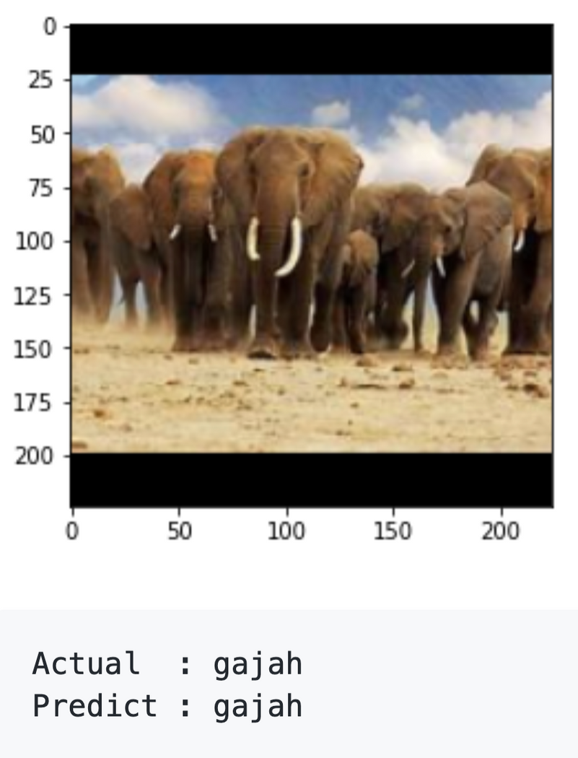

Slide 26
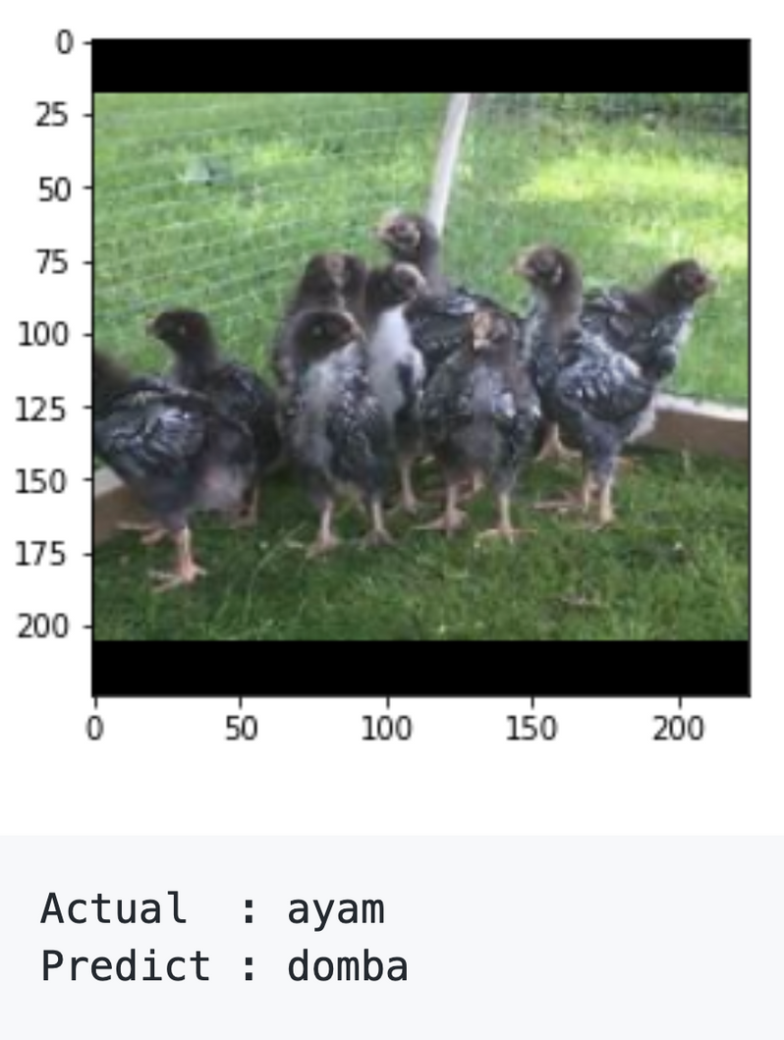
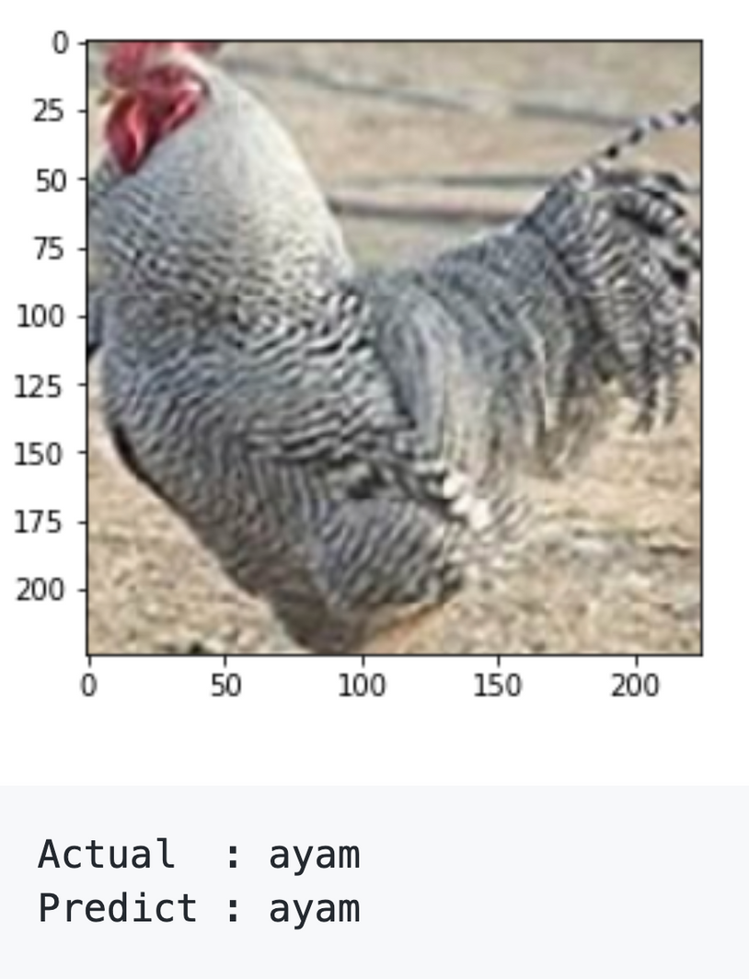
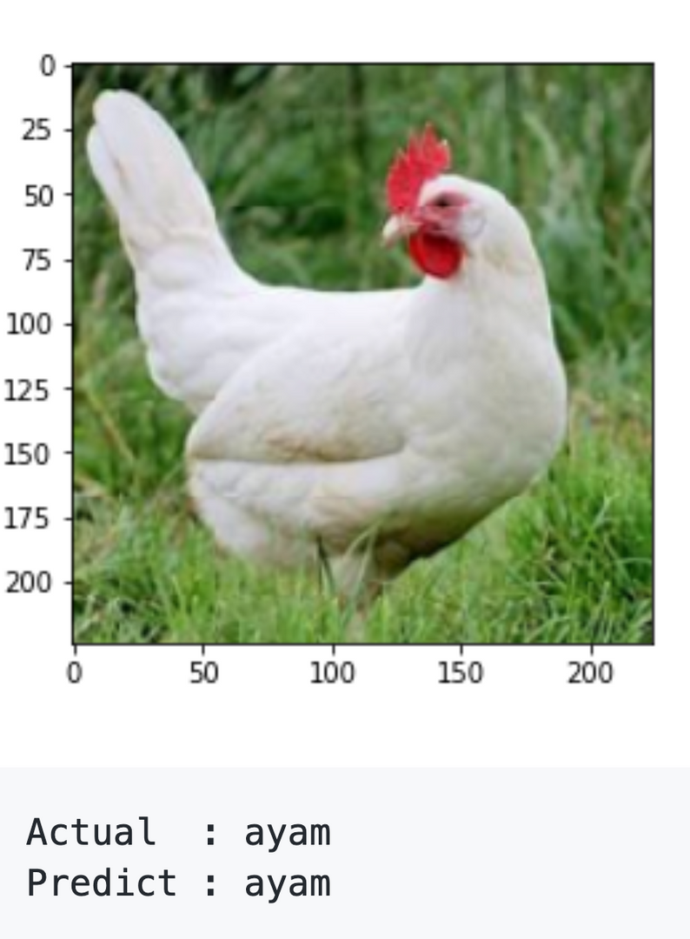

Slide 27
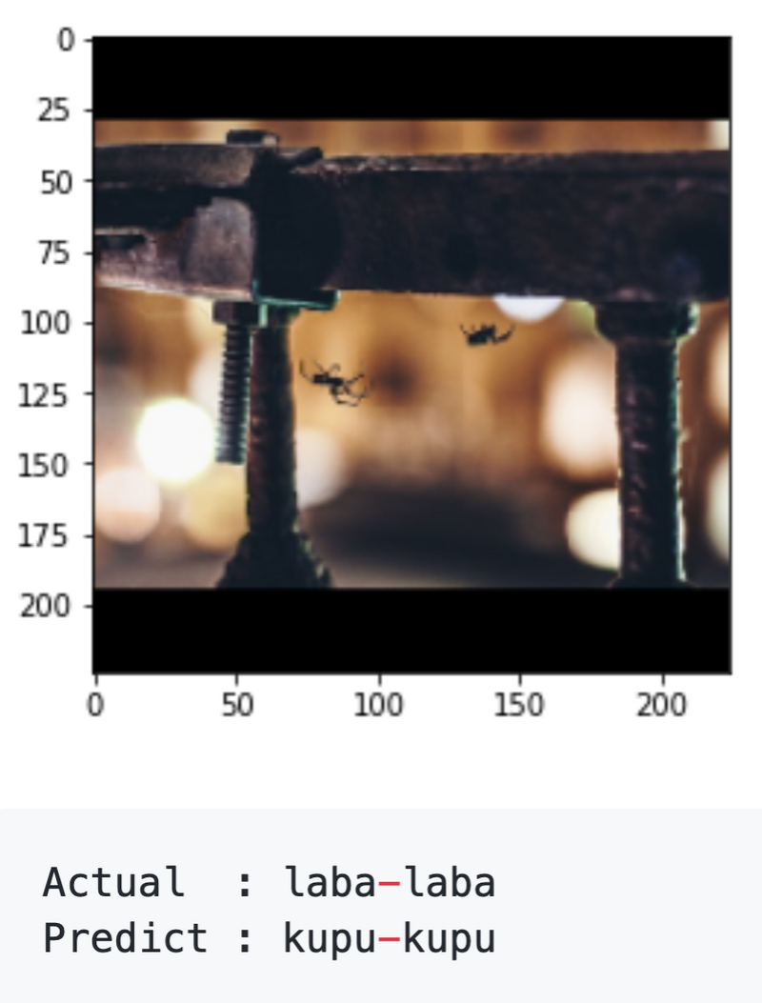
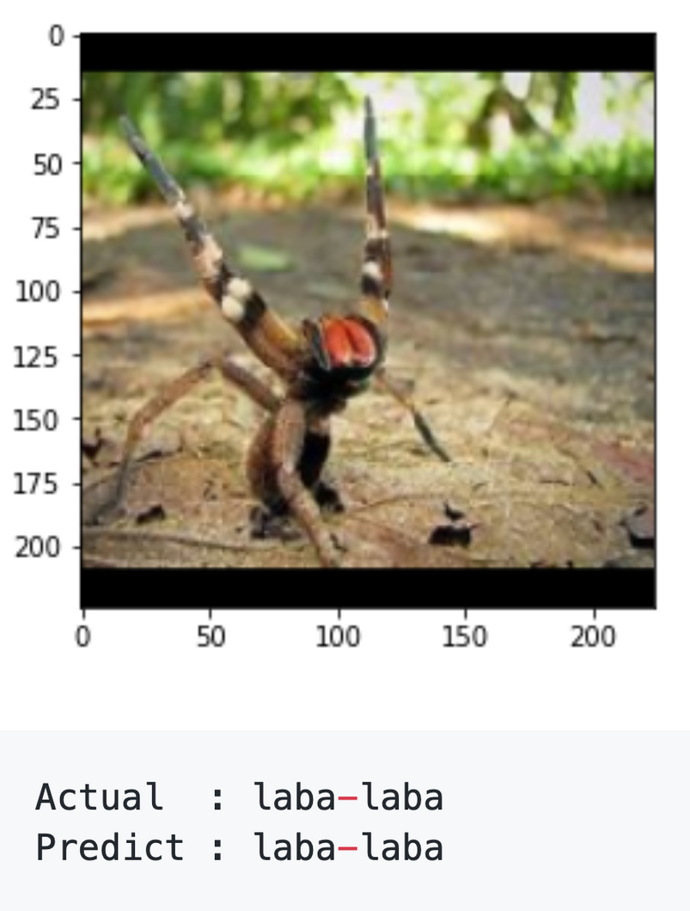
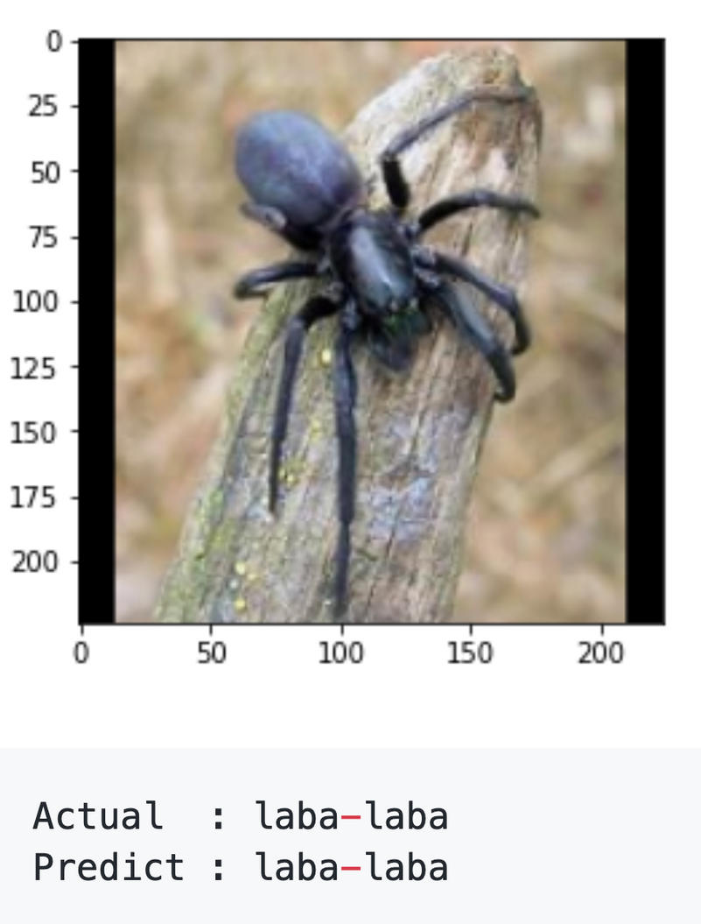

Slide 28
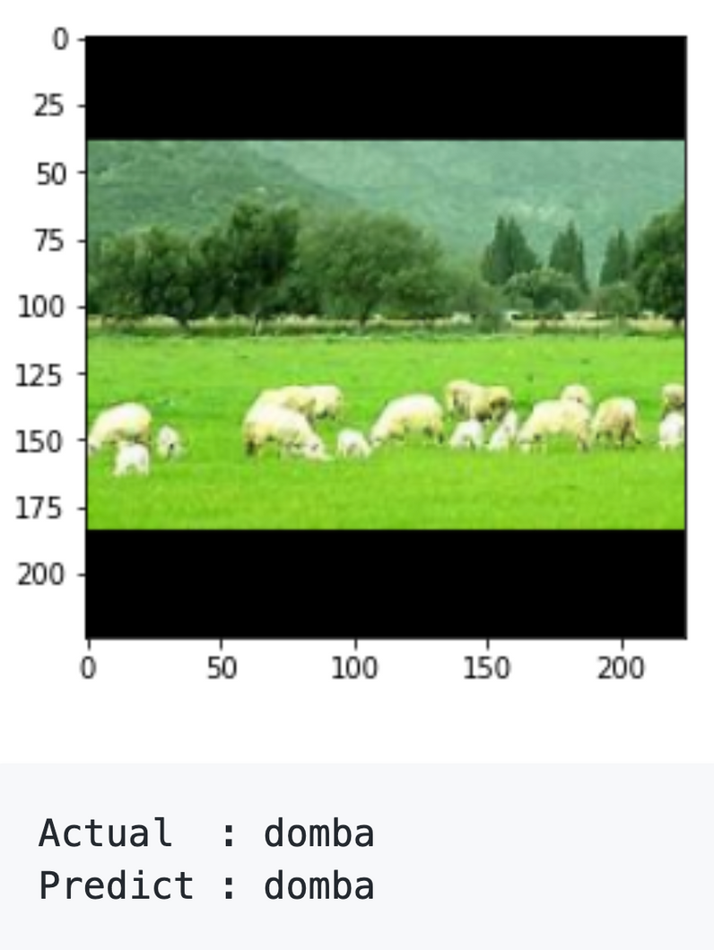
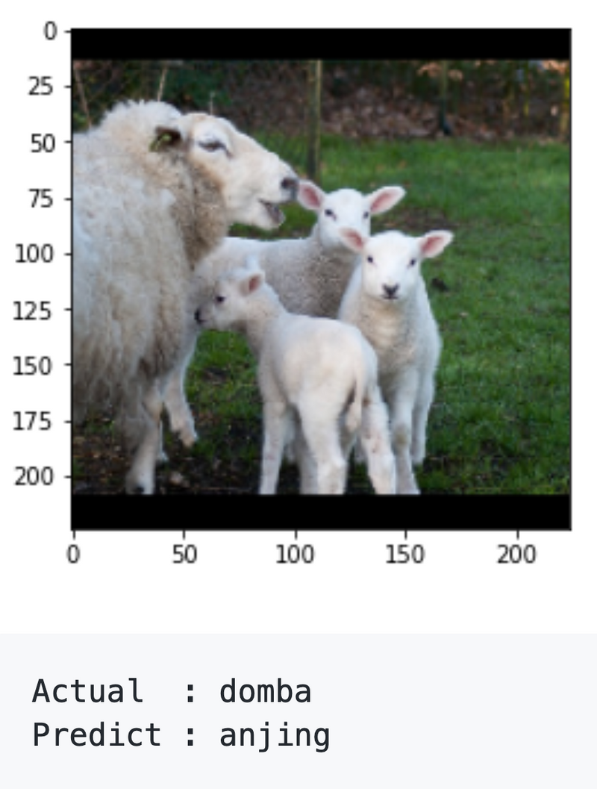
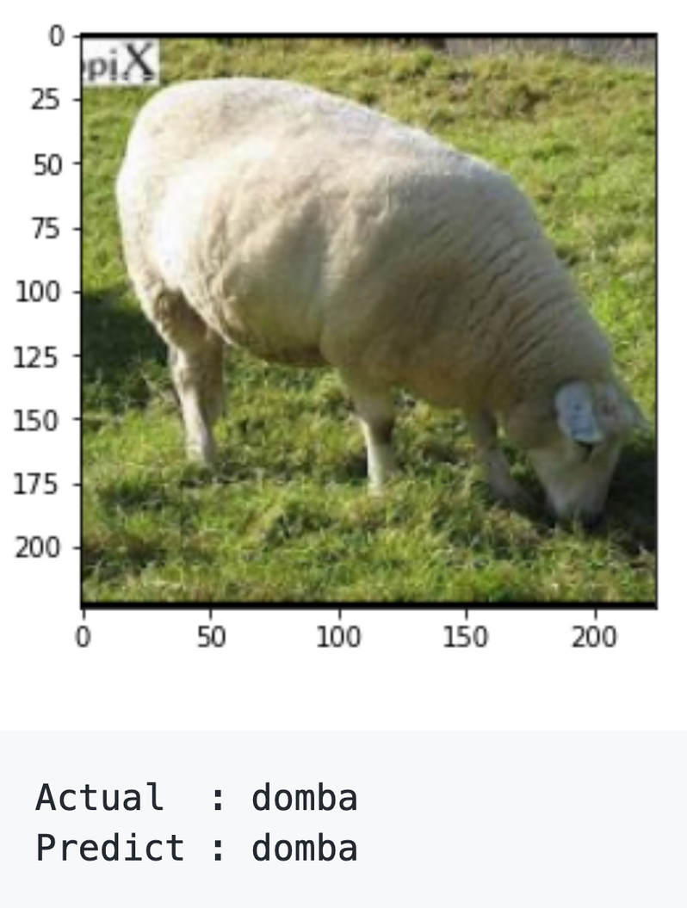

Slide 29
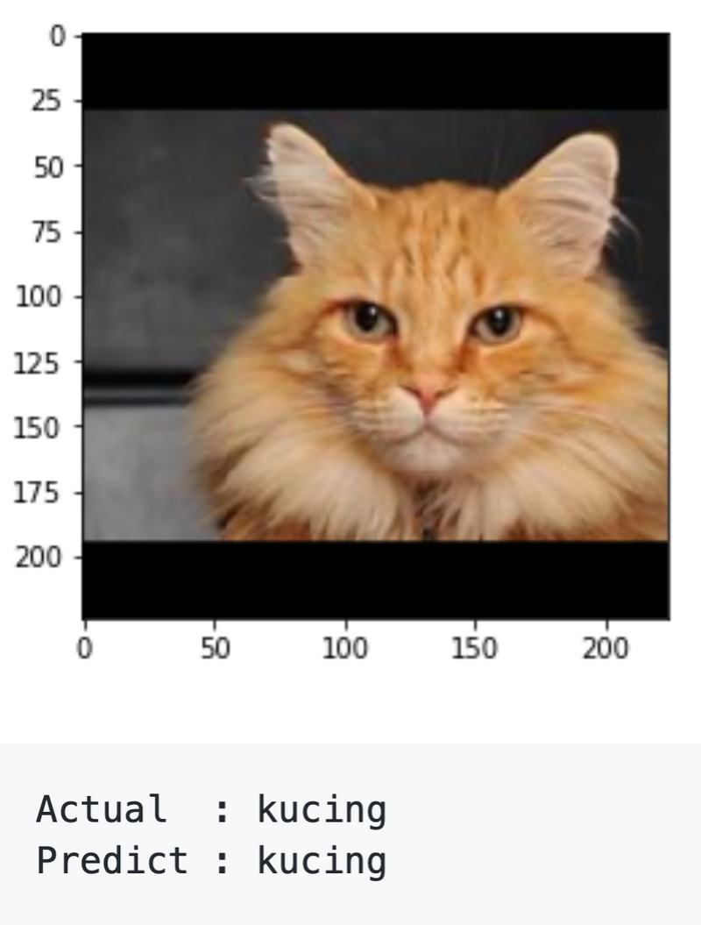
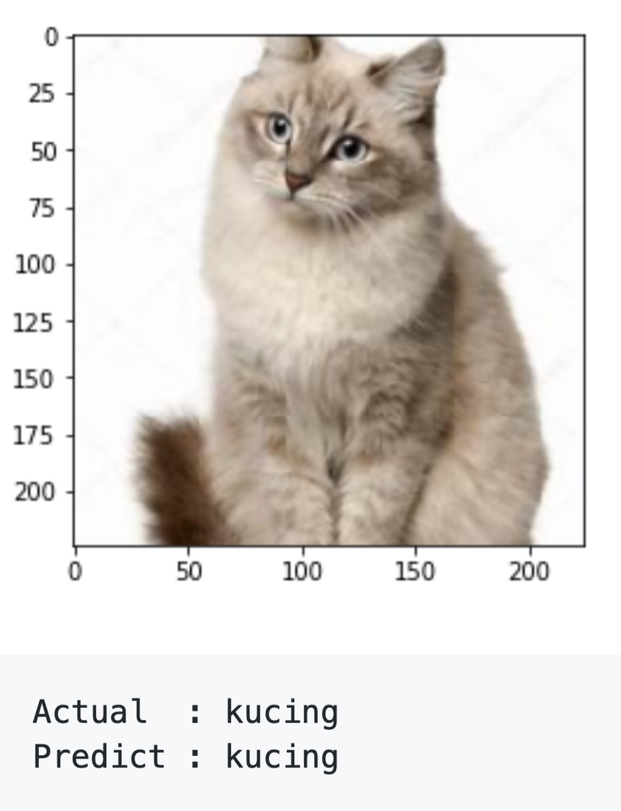
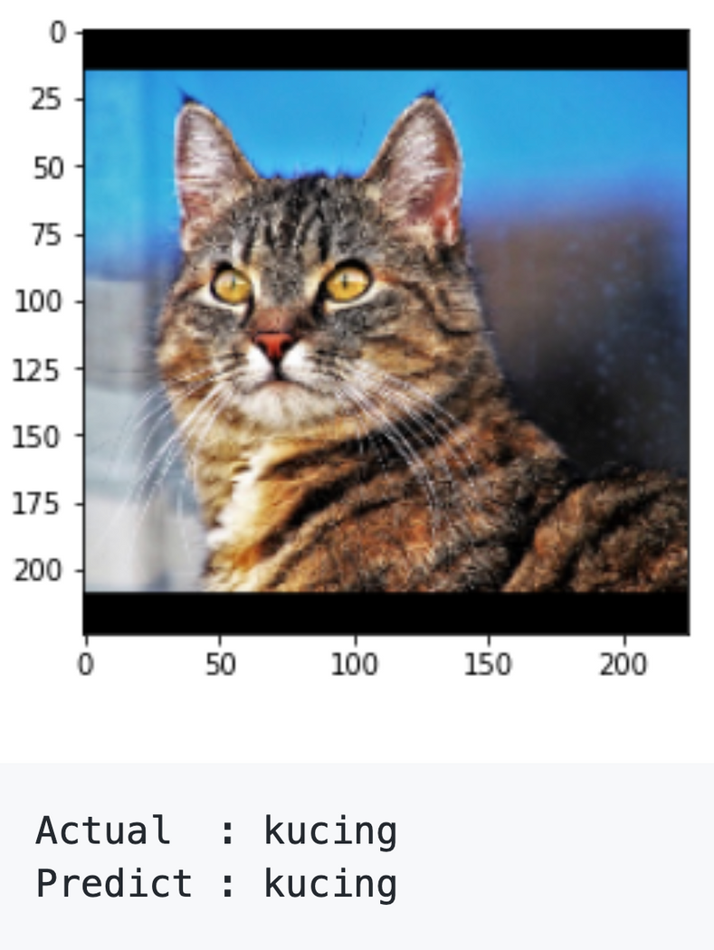

Slide 30
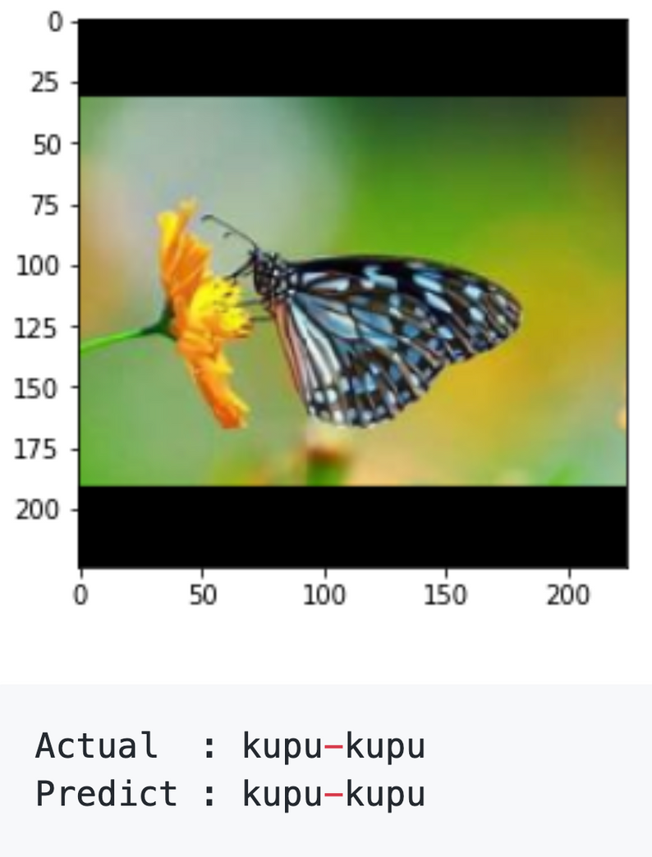
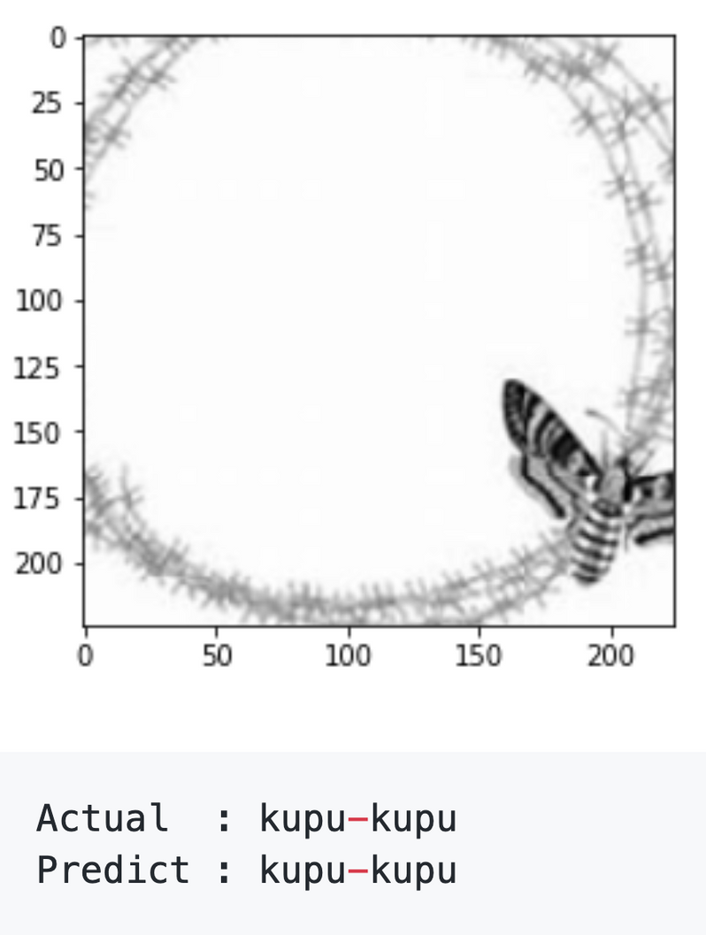
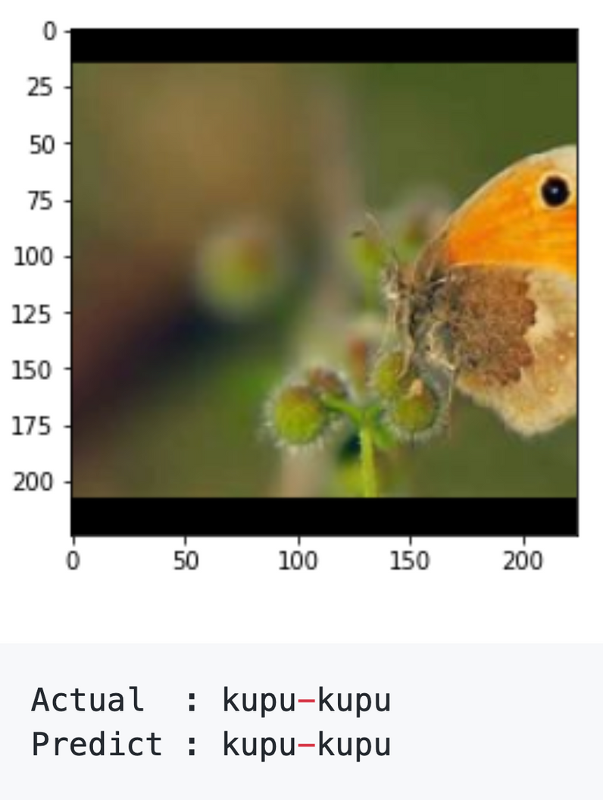

Slide 31

SIMULASI

Slide 32

terimakasih
- KELOMPOK 4 -

